Slide 1
Hackathon Spring-2018 Use Case 15:UM CHATBOT
“GAME OF CODERS”
TEAM MEMBERS:
Sneha Didigam
Adarsh Mergoju
Ravali Nalla
Sreelekha kommareddy
GITHUB LINK( Source and More Screenshots):
https://github.com/snehadidigam/hackathon2018

Slide 2
OBJECTIVES AND FEATURES:
This web application was to develop a college enquiry chat bot which answers any queries posed by users like professor’s contact details, course related questions and location of university buildings, this application helps the students to access the university related information.
This system also has a frequently asked questions which will be added by admin for user’s convenience.
The user must register to access the system and then login to the system, and then chat with the system.
The system retrieves the information from the UMKC websites.
This application allows the users to change the chat theme.
The home page allows the access to the pathway, outlook, blackboard and UMKC websites
TECHNOLOGIES USED:
Code Development Tool Kit : Visual studio
Programming Language: Java script
Designing UI screens: Html
Versioning: GITHUB TOOL

Slide 3
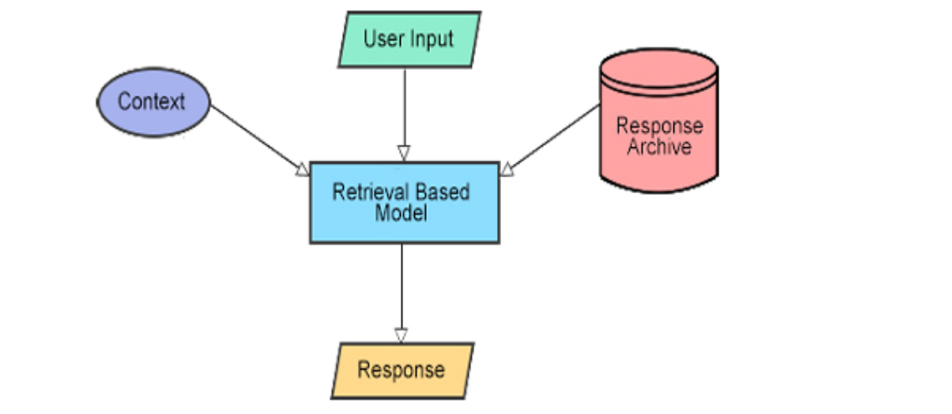
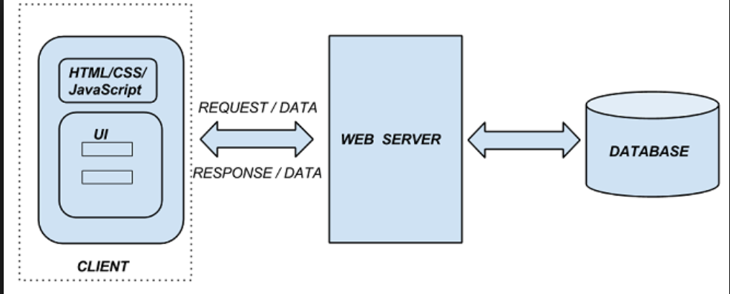
ARCHITECTURE:

Slide 4

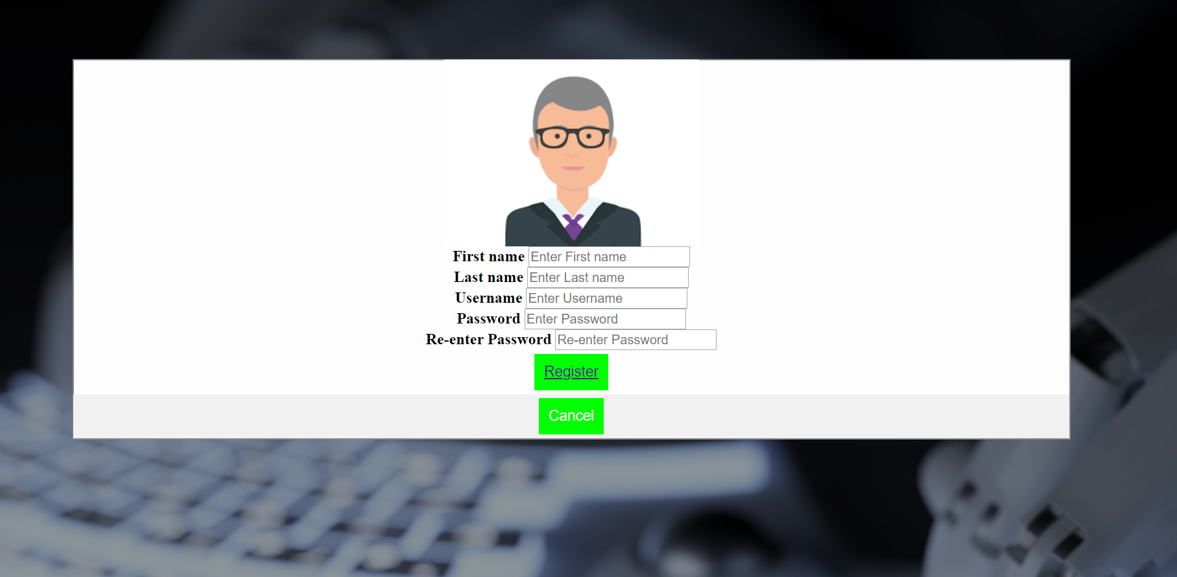
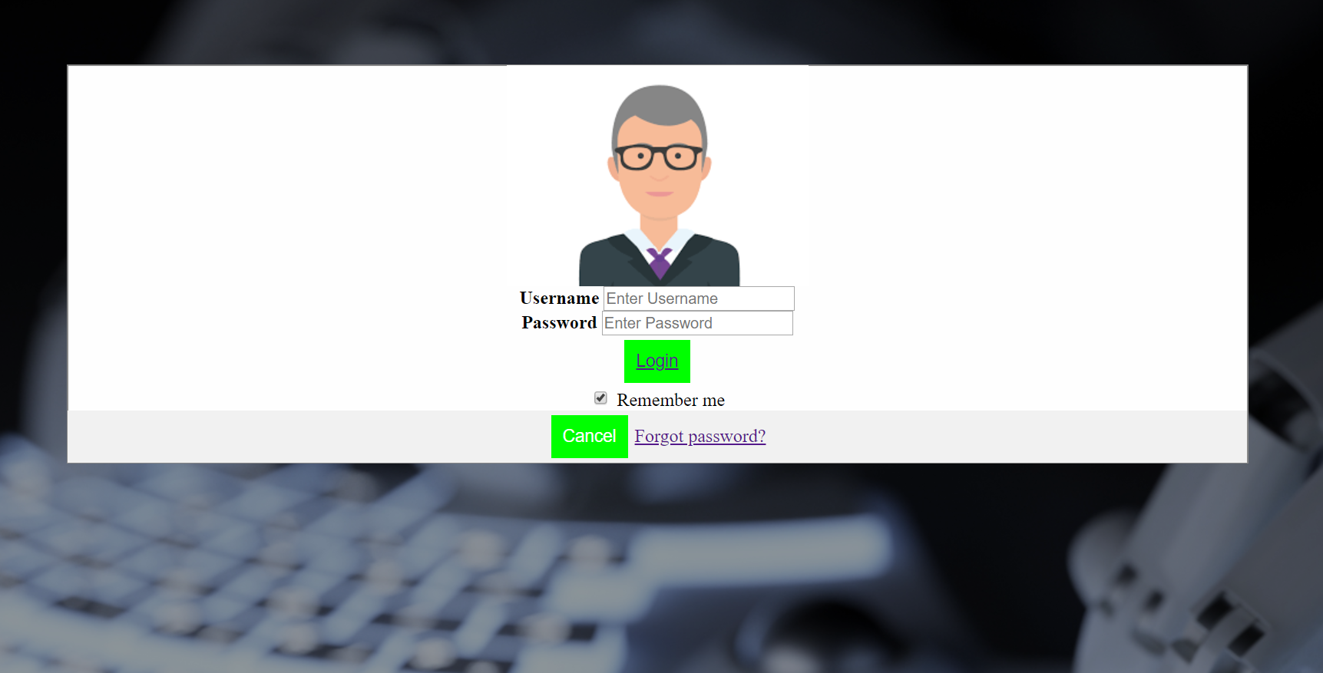
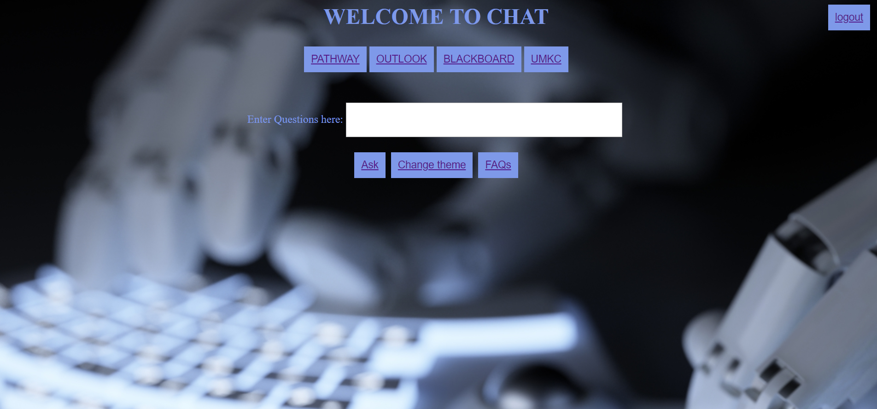
SCREENSHOTS:
1.
Home
page
2. Registration
page
3. Login
page
4. Main page

Slide 5
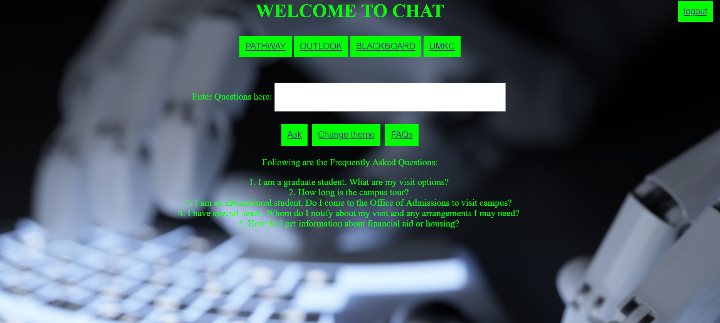
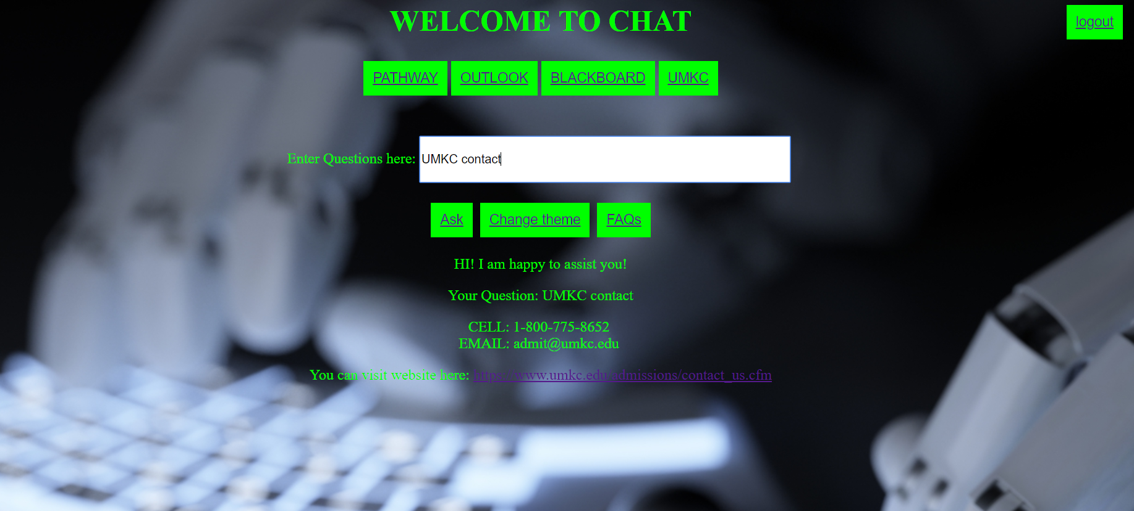
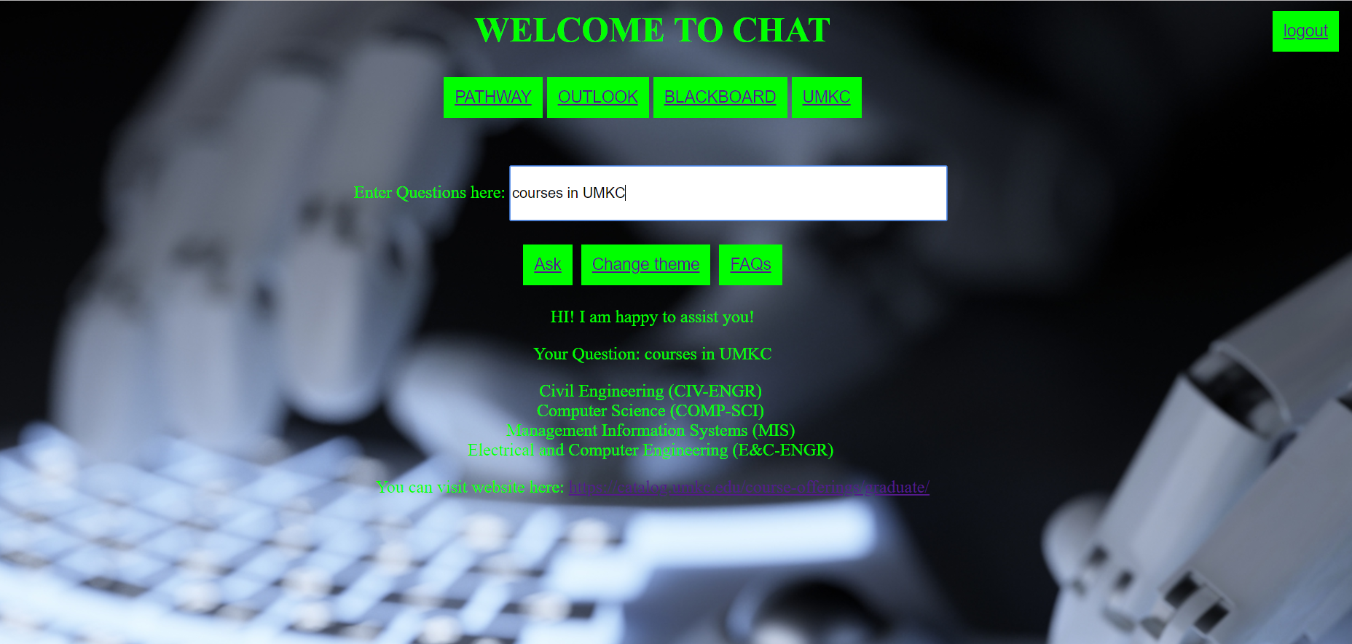
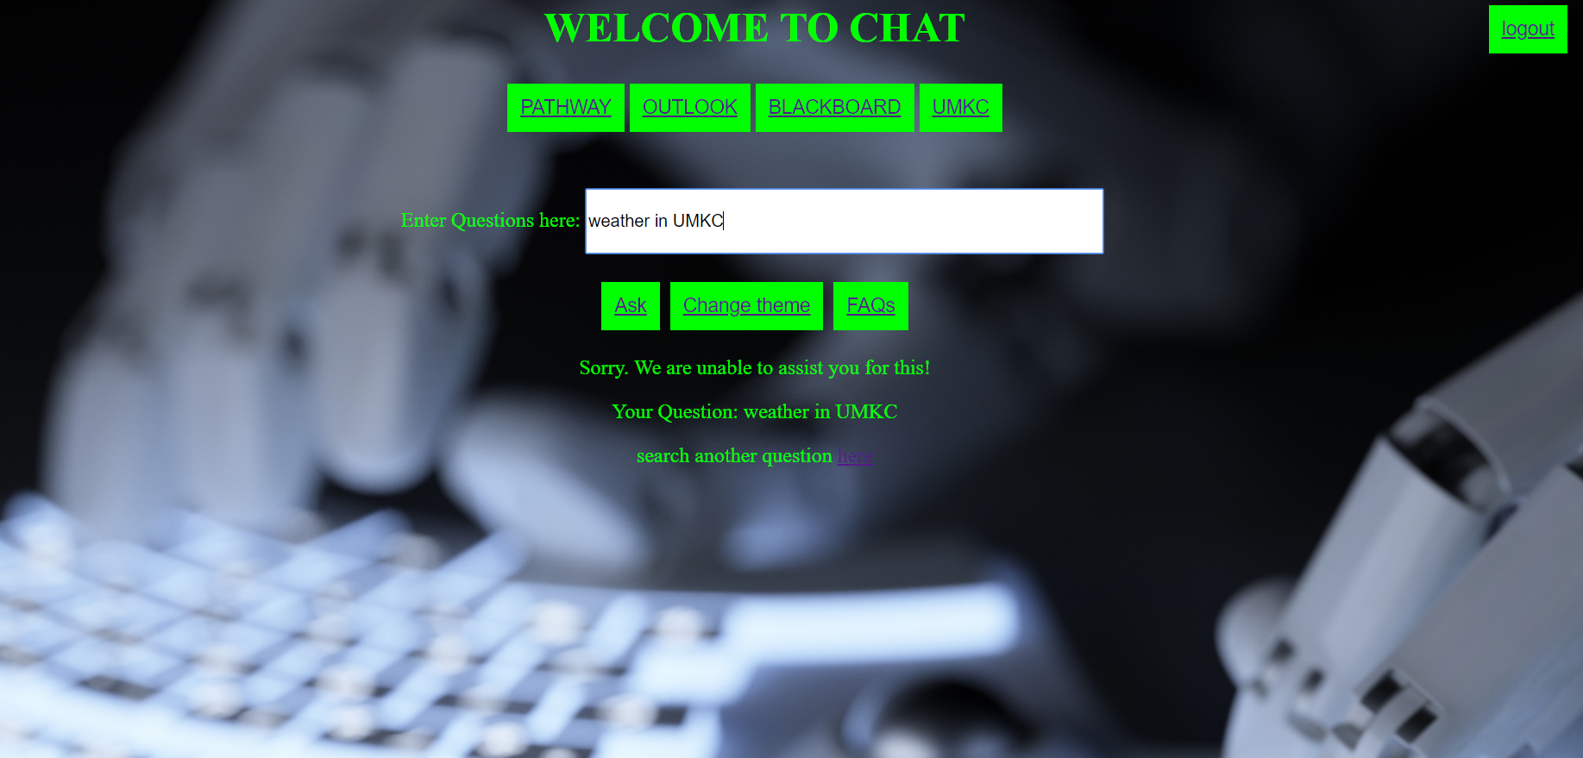
SCREENSHOTS:
6.
5. Faq’s
7.
8.

